Slide 1



A method helping to define eco-innovative systems based on upgradability
by
O. PIALOT , D. MILLET , E. COR and J. BISIAUX
Presenting Author: O. PIALOT
LISMMA, Supmeca Toulon
Toulon, France
Olivier.pialot@supmeca.fr

Slide 2
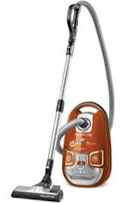
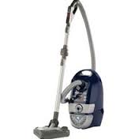
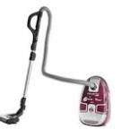

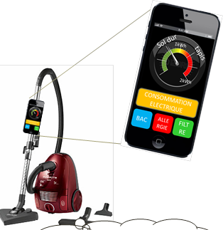
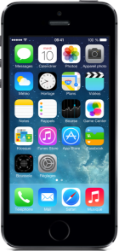
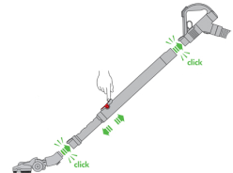
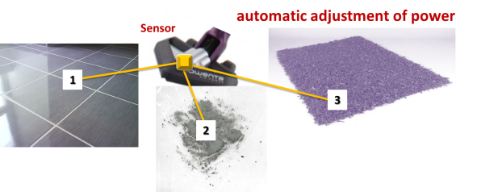

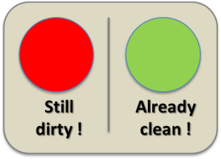
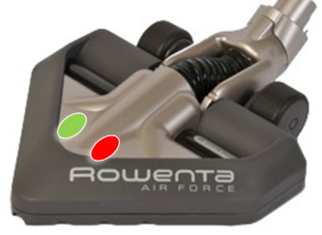
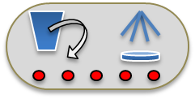
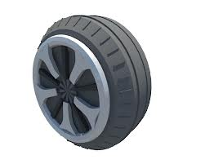





12 kg
6 years
12 kg
6 years
12 kg
6 years
Conventional Product
APP
Eco-score
APP coach v1
APP coach v2
APP coach v3
Dirty indicator
Ergonomic handle
APP
purchase
Council of power adjustment
Alert "Full tank & clogged Filter"
Smartphone connector
Less pressure loss Filter
Easy Wheels
Calories meter
2 years
2 years
2 years
2 years
2 years
2 years
2 years
2 years
2 years
APP coach v4
12 kg
Upgradable
System

Slide 3
Plan
1. The fruitful concept of Upgradability
2. How to do it? Methodological Elements

Slide 4
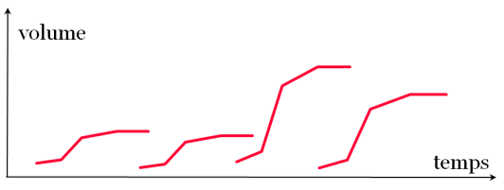
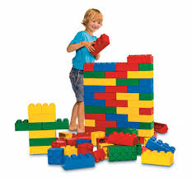
SUSTAINABLE Innovation
with multiple Upgrade Cycles
« disposable»
Innovation
Change of consumption mode
ENVIRONMENT
Sust. Dev.
SOCIAL
ECONOMIC
Lifetime depends on:
. Physical LifeTime (PLT) [lifetime related to the reliability/wear]
. Value LifeTime (VLT) [lifetime related to the obsolescence phenomenon]
[Umeda et al.] [Kondoh et al.]
UPGRADES = funtional enrichment, integrated to the product per sequence
t=0
t=0+2years
t=0+4years
Modular system
Time
Product functionalities evolution over time

Slide 5

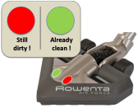
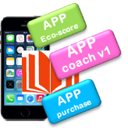
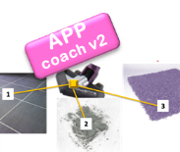
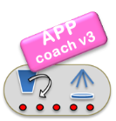




12 kg
6 years
12 kg
6 years
12 kg
6 years
Conventional Product
12 kg
24 kg
36 kg
Service bundles with module Upgrades
2 years
2 years
2 years
2 years
2 years
2 years
2 years
2 years
2 years
12 kg
1 kg
Upgradable
System
1kg
1 kg
1 kg
1 kg
1 kg
1 kg
1 kg
14 kg
17 kg
20 kg
in 6 years
Material Gain + 17 %
in 12 years
Material Gain - 29 %
in 18 years
Material Gain - 45 %
Material Consumption reduction until - 45 %
> Material Consumption reduction until - 70 % ?
Earth
Energy consumption reduction

Slide 6


12 kg
6 years
12 kg
6 years
12 kg
6 years
Conventional Product
1
2
3
Service bundles with module Upgrades
2 years
2 years
2 years
2 years
2 years
2 years
2 years
2 years
2 years
12 kg
1 kg
Upgradable
System
1kg
1 kg
1 kg
1 kg
1 kg
1 kg
1 kg
UPGRADABILITY SUPPORT SERVICE
9
x2
Company
Opportunities to make benefits

Slide 7

12 kg
6 years
12 kg
6 years
12 kg
6 years
Conventional Product
Service bundles with module Upgrades
2 years
2 years
2 years
2 years
2 years
2 years
2 years
2 years
2 years
12 kg
1 kg
Upgradable
System
1kg
1 kg
1 kg
1 kg
1 kg
1 kg
1 kg
Increasing attractiveness
Added Value for customer
Customer

Slide 8
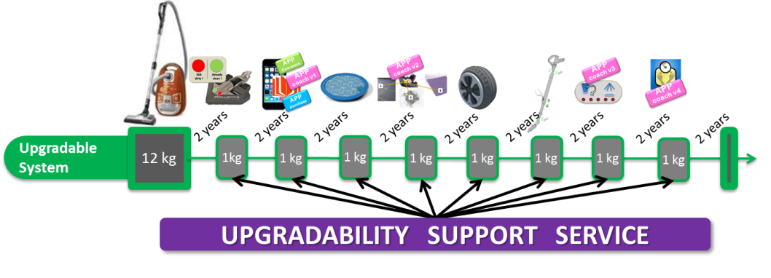
Business
Environment
Company
Earth
Range of new Services associated to the product
Upgrading
Triple win !
Service bundles with module Upgrades
Customer
Customer
Trojan horse to migrate
to service offerings !!!!
[BEC diagram]
Notes:
To conclude this part, the upgrading concept is very interesting because the principal stakeholders are satisfied. We are in a Triple win configuration!
Moreover, Upgradability is an opportunity to disseminate servicizing mode!
The difficulty of Servicizing is to imagine new services linked to the product with added value repeated over time to justify the switch to a form of sale without transfer of ownership. To remedy this, upgrading brings range of new services (linked to the product and with added value):
Firstly the upgradability support service necessary to integrate upgrades to the product
Secondly Service bundles related to “connected objects”, apps catalog.
Upgradability with its multiform and evolutive offer is also a « Trojan Horse » to migrate to service offerings like « all inclusive package ».

Slide 9
Plan
1. The fruitful concept of Upgradability
2. How to do it? Methodological Elements
Notes:
Now, PART 2, Methodological Elements to generate an upgrade scenario and a business model for upgradability

Slide 10
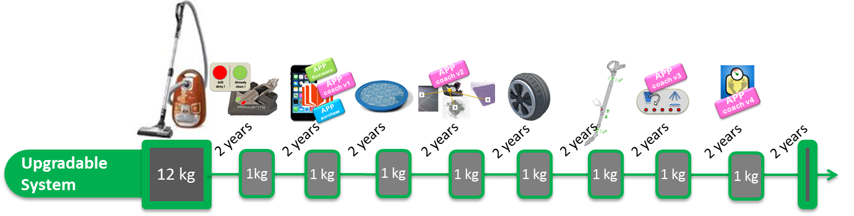
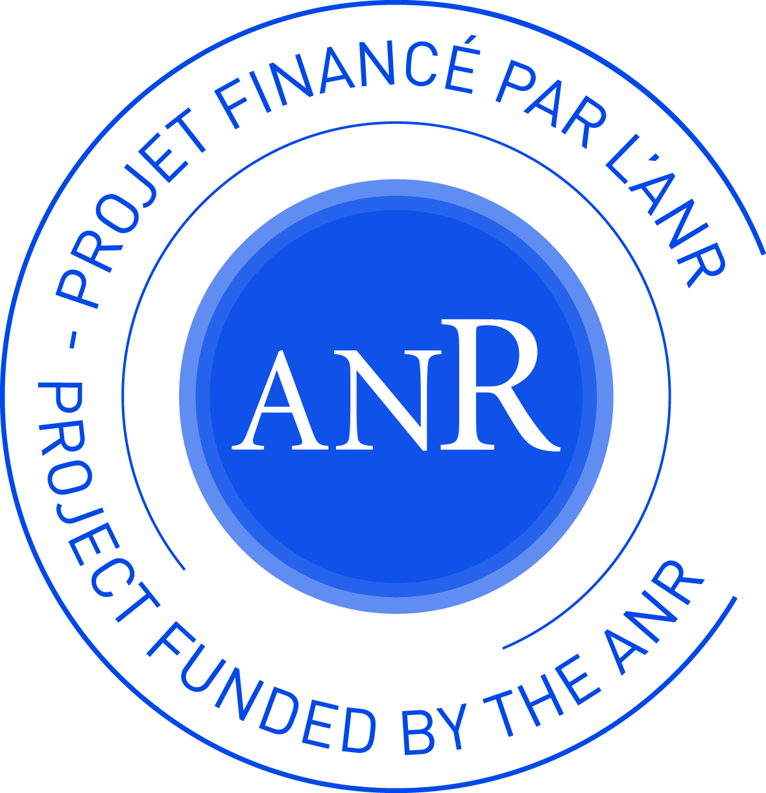







New Questions related to Upgradbility
Upgrade scenario
How much cycles?
How long?
What type of upgrade?
How to sell upgradability?
How to share the value?
How to supply upgradability service?
Business model
ANR Ecotech
Research Program
2012 → 2015
Design for Upgradecycling
State of the art, Analysis, Quantitative study, Focus group, Workshops Upgradability … until the definition of a design method for upgradecycling & Tools associated
Notes:
With upgrading, new questions arise!
In particular,
How much cycles? How long? What type of upgrades? Etc. Related to that we named Upgrade scenario
And
How to sell upgradability? How to share the value? How to supply upgradability service? How to distribute these upgradable systems? Related to the business model
Based on different works of the IDCyclUM Project consortium composed of 5 academic partners and 2 industrial companies, a design method for upgradable system have been developped.

Slide 11
Upgrade scenario
Planning of upgrades with regular cycles
. Ensure triple win “attractiveness for customer, environmental gains and benefits”
. Visibility about futures features of the system
. Technological cycles are regular
  Upgrade line Set of upgrades performed over several cycles
. Each customer has purchase priorities
. Manufacturer focusses on certain performance criteria over time
according to the requirements of the market, the company identity and strategy
. It’s interesting to be leader/proactive on specific performance and to repeat this added value over time
Themes of value creation
t=0
t=0+2years
t=0+4years
  Motor power
90 W
120 W
140 W
  Upgrade line 1
  Battery
12 V
18 V
24 V
  Upgrade line 2
Performance
  Perf. x
  Upgrade line 3
  Perf. y
  …
Sensory
  Design
  Acoustic
Green
  Energy efficiency
  …
Service
Time

Slide 12
Upgrade scenario for vacuum cleaner Rowenta
Easy Wheel
Ergonomic Handle
Delta head
Handling
New filter
New cyclone
New Accessory
Suction
Choice
Look 1
Look 2
Look 3
Design
Product/ Service Upgrade Lines
Task report
Power Mgt
Clogged filter
Eco-usage
Pacman
Ghost
Hunter
Game Service
Offer Structuration
Calorie counter
Aerobic exercices
Analyse of dust
Health Service
Up Sa2
Up Sa3
Up Sa4
Opti Service
On Catalog
Up X
Up Op
Malaise alert
Accessories for car
Stickers
Up G
Up Ac
Up H
Up D4
Upgradable
System
2015
2017
2019
2021
Cycle 1
Cycle 2
Cycle 3
Cycle 4

Slide 13
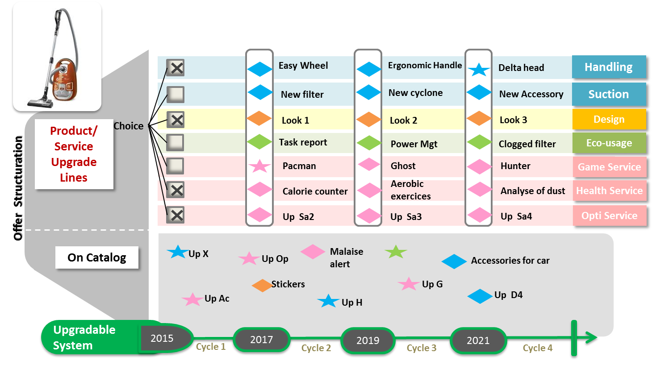
New Questions
Upgrade scenario
Business model
How to sell upgradability?
How to share the value?
How to supply upgradability service?
How to distribute these upgradable systems?
Material good centred business model
??? Business Model
Servicial Business Model
Short term
Middle term
Long term

Slide 14
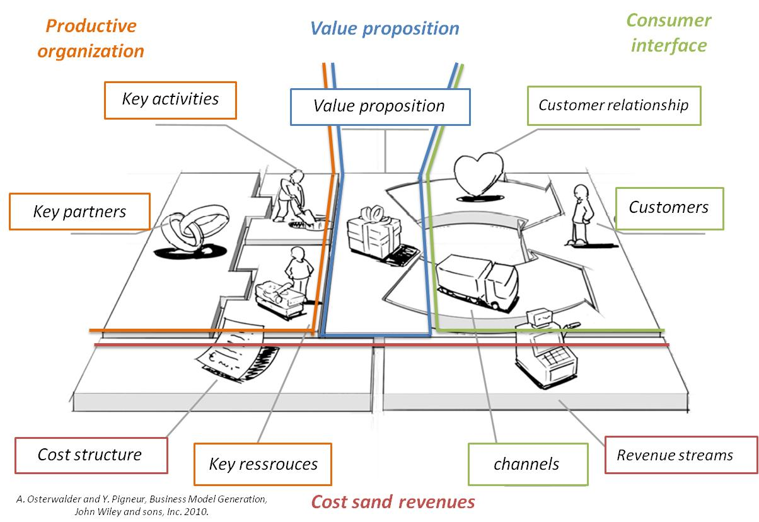
Business model
Service bundles with module Upgrades
Offer
UPGRADABILITY SUPPORT SERVICE
Network
Contracting

Slide 15
Business model
A trajectory to reach sustainable business models
Upgrades
Upgrades
Business Model consistent with sustainable innovation (uses centred)
Material good centred Business Model
Hybrid Business Model
Uses centred BM
material good centred BM
Short term
Middle term
Long term
Hybrid Business Model
material good centred Business Model
Hybrid Business Model
Uses centred BM
The size of the circles represents the relative importance of the turnover of the business model involved

Slide 16
Design for Upgradecycling method
goal of method:
define an upgradable system and its Business model.
Founding principles:
A workable guide helping the designers
In the early design phases, before the product specification phase
The necessity of a multidisciplinary team
A multicriteria assessment of an upgradable system (economic, environmental and attractiveness)
A design method without a priori knowledge in 2 Rounds

Slide 17
Design for Upgradecycling method
Business & Product strategies
Product Team (R&D, design, Eco design, Marketing, Innovation, purchasing department, manufacturing …)
Service Team (Service engineering, customer service, environment expert, Marketing, Innovation …)
Team “Supply Chain” & “Reverse supply chain”
+ Team “Sales, Marketing, Legal department”
Business model Team (product chief, Innovation, Finance, Marketing, Diversification, Logistics)
Analyse from a multidisciplinary point of view the current system (market, customer segments, stakeholders, development process, LCA …)
ROUND 1
ROUND 2
Exploration Phase
Combination & Refinement Phase
Targeted Customer segments
Trajectories from current value network towards Value Network for Upgradable system
Assess Upgradable System concepts – UpSys
(detailed Value Network + UpMoS + Added Services + Eco-learning service):
. Environmental
. Economic.
. Attractiveness
& Choose the most relevant
Specify the business model associated
Knowledges related to the current product, Business model, supply chain …
Explore potential business models for upgradability & their transitions
List of retained VaNS (type of offer, contract, partners, network)
Build Upgrades modules Scenario
& select the most promising
Specify Value Network for each promising UpMoS
Current distribution Network
Explore potential Value Network Structures (VaNS) and their transitions
For each VaNS retained,
build Upgrades Modules Scenario – UpMoS
(including transitional modules, PMoL, SMoL & unit upgrades)
& select the most promising UpMoS
Detailed Value Network for each promising UpMoS
Analysis Phase
A8
Demonstrator development & Assessment Phase
A3
Transitional Modules
Assessed & prioritised UpSys Concepts
Acceptability domains of upgradability/consumer
2 possibilities (Number of cycles; Duration
of cycle)
Explore Product Modules lines
List 1 of Product Modules Lines + unit upgrades
Retained customer segments
List of current modules
Explore potential Product Modules Lines (PMoL) for upgradable system
Retained customer segments
A1
Promising UpMoS
List 2 of Product Modules Lines + unit upgrades
Define Acceptablity domains of upgradability
A4
Trajectories of value network associated to Upgradable system
Analysis Results
Explore Service Modules lines
List of Eco-learning Modules Lines
Definition of consolidated added Services
Product Value creation Themes
Explore potential Service Modules Lines (SMoL) for upgradable system, including eco-learning service
Service Value creation Themes
List of Services Modules Lines
Consolidate Eco-use Service & others added Services
A9
A2
A6
A5
Definition of Eco-learning Service
Definition of consolidated Eco-learning service
Definition of other added Service
A7
UpPA Pre selector Tool (Upgradability Parameters Pre selector)
27 generic structures of Value Network
UpMoL explorer Tool (Upgradability Modules Lines Explorer)
UpELS explorer Tool (Upgradability Eco-learning Strategy Explorer)
UpVaN explorer Tool (Upgradability Value Network Explorer)
LCA Tool
LCC Tool
WTP Tool (Willingness to pay)

Slide 18
Intermediate representation to explore the business models for Upgradability
3 dimensions to build business models and form trajectories
Upgrade offer
27 combinations
. One fixed upgrade line
. Choice of one or several upgrade lines
. Use of upgradable system
Network
. Partitionned (producer / distributor)
. integrated (one major actor)
. Networked (plurality of actors)
Contracting
. product and upgrades purchased
. product purchased, upgrades under contract
. product and upgrades under contract

Slide 19
Intermediate representation to explore
Product upgrade lines
Value Creation Themes (VaCT)
Number of Upgrade lines integrated
Perf
Senso
Green
P1
Handling
P2
Suction
S
Design
G
Efficiency & Eco-usage
N:1
P1 or P2 | S | G
P1-P2 or P1-S or P2-S or S-G or P1-G or P2-G
P1-P2-S or P1-P2-G or P1-S-G or P2-S-G
P1-P2-S-G
Total = 4
Total = 6
Total = 4
Total = 1
N:2
N:3
N:4
30 combinations
NC=4/DC=2
Structure of Upgrade Cycle
(Number of Cycle-NC- Duration of cycle-DC)
NC’/DC’

Slide 20
Intermediate representation to explore
Service upgrade lines
Value Creation Themes (VaCT)
Number of Upgrade lines integrated
Service
S1
Game
S2
Health
S3
Optimisation
N:1
S1 or S2 or S3
S1-S2 or S1-S3 or S2-S3
S1-S2-S3
Total = 3
Total = 3
Total = 1
N:2
N:3
14 combinations
NC=4/DC=2
Structure of Upgrade Cycle
(Number of Cycle-NC- Duration of cycle-DC)
NC’/DC’

Slide 21
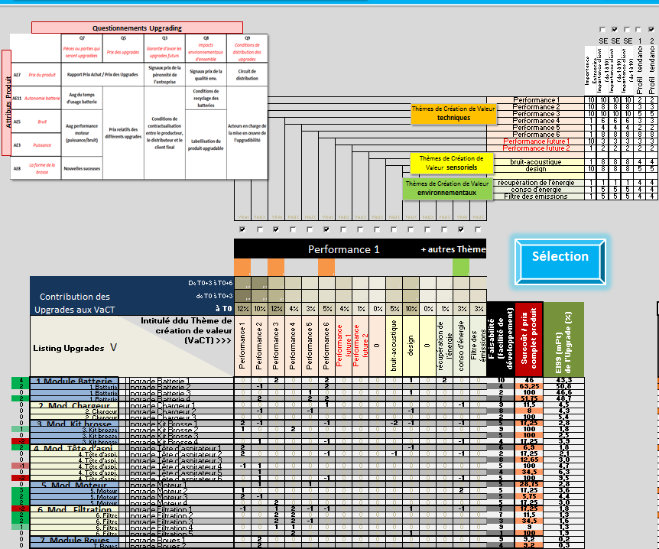
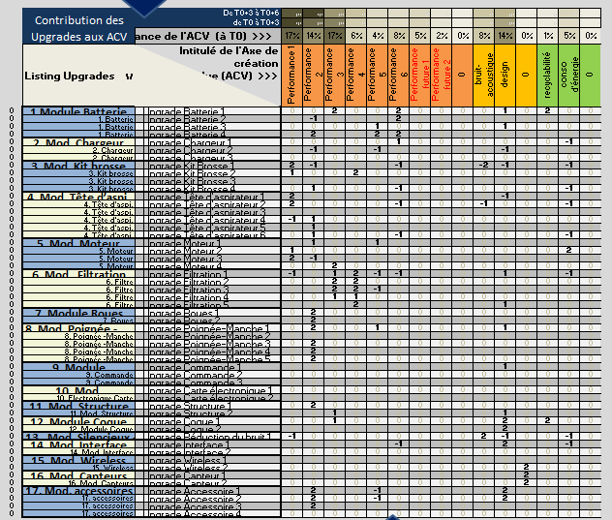
UpMoS Explorer
Quantify the contribution of upgrades to value creation themes
Imagine new Modules related to Value creation Themes (VaCT)
. Performance
. Sensorial
. green
Characterize upgrades listing:
. Integration date
. Feasibility
. Cost
Generate technological evolutions of current modules

Slide 22
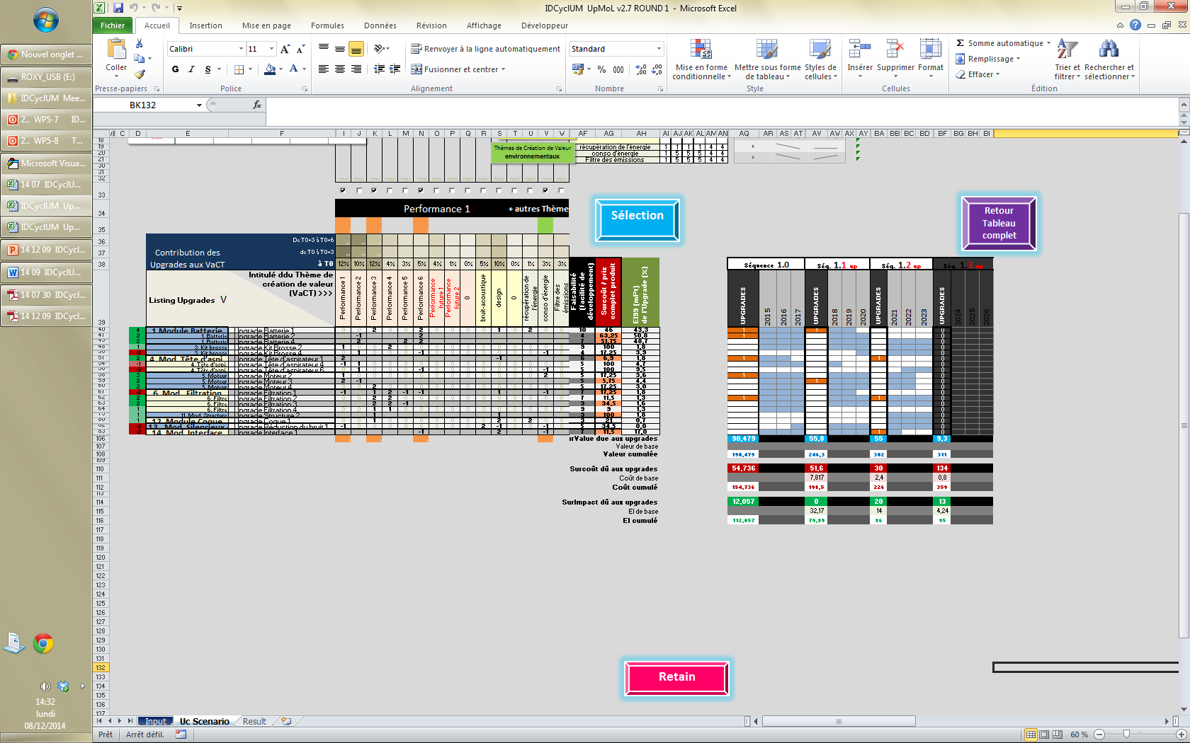
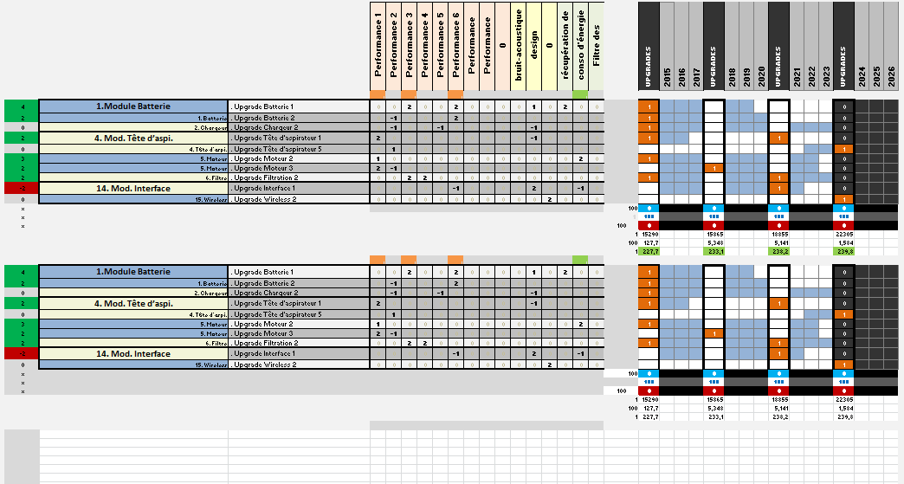
UpMoS Explorer
Generate Upgrades lines
for each VaCT or combination of Vact
For each upgrade cycle format (NCi;DCi)

Slide 23
Upgrade scenario with Upgrade lines
Themes of value creation /Performance / Sensory / Green / Services
Catalogue of upgrades
A new concept of Production / Consumption Mode
Bundle of associated services
An improved offer based on a dynamic of upgrades and services
Extension of lifetime
Optimised EOL (no waste)
1
Increasing Attractiveness
Dematerialisation through services
Guaranteed environnemental gain
2
Upgradable-PSS
Up-PSS
Green passport
Dynamic of upgradability based
on client-producer interaction and business model development paths
Business Models
Trajectories
Help towards eco-usage
3
Transitional Upgrades
UpWebPlatform
Logistic support for integrating upgrades
A new design method for upgradecycling
Flexible contracting
New design tools to support design team

Slide 25
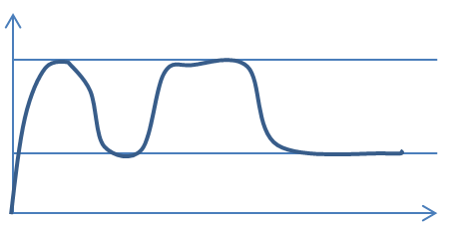
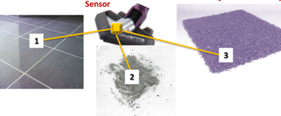

Service of Eco-usage-feedback
APP
Eco-learning
Power & time report
Power management
Clogged filter
Energy Consumption / per use (average)
Conventional Product
Energy consumption reduction
by Eco-usage
6 years
30W.h
Learning Program
of eco-usage
28W.h
26W.h
25W.h
12 kg
Upgradable System
1kg
1 kg
1 kg
2 years
2 years
2 years
Time

Slide 26
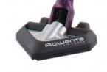
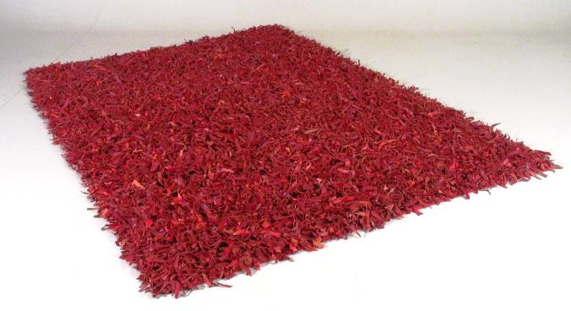
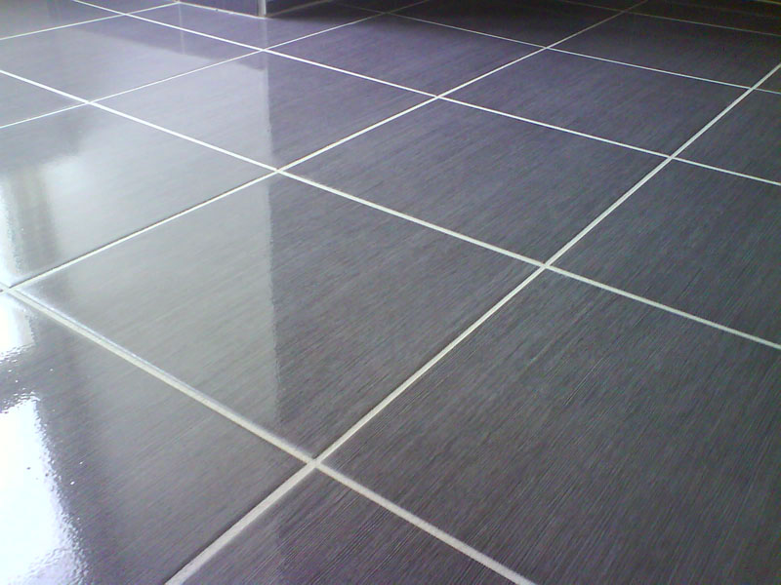
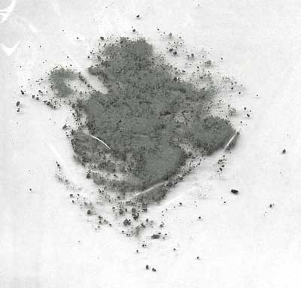
automatic adjustment of power
Sensor
1
3
2
Still dirty !
Already clean !
Alert "Full tank & clogged Filter"

Slide 27

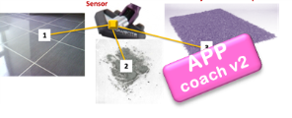
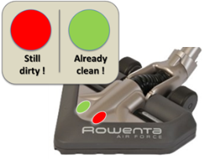

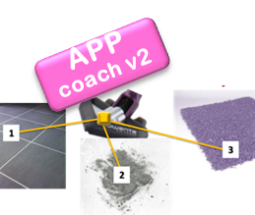
APP coach v2
APP
Eco-score
Alert "Full tank & clogged Filter"
APP coach v1
Ergonomic handle
APP
purchase
Council of power adjustment
APP coach v3
Smartphone connector
Less pressure loss Filter
Easy Wheels
APP coach v4
2 years
2 years
2 years
2 years
2 years
2 years
2 years
2 years
2 years
12 kg
Upgradable
System

Slide 28
2 years
2 years
2 years
2 years
2 years
2 years
2 years
2 years
2 years
12 kg
1 kg
Upgradable
System
1kg
1 kg
1 kg
1 kg
1 kg
1 kg
1 kg
UPGRADABILITY SUPPORT SERVICE

